Slide 1
Digital Parking Control System

Slide 2
Agenda
Block Diagram and Flowchart Development
4-bit UP/DOWN Counter
Two 555 Timer Circuits
7-Segment Display Output
FSM (Finite State Machine)
Verilog HDL Code
Limitation & Suggestion Sectio

Slide 3
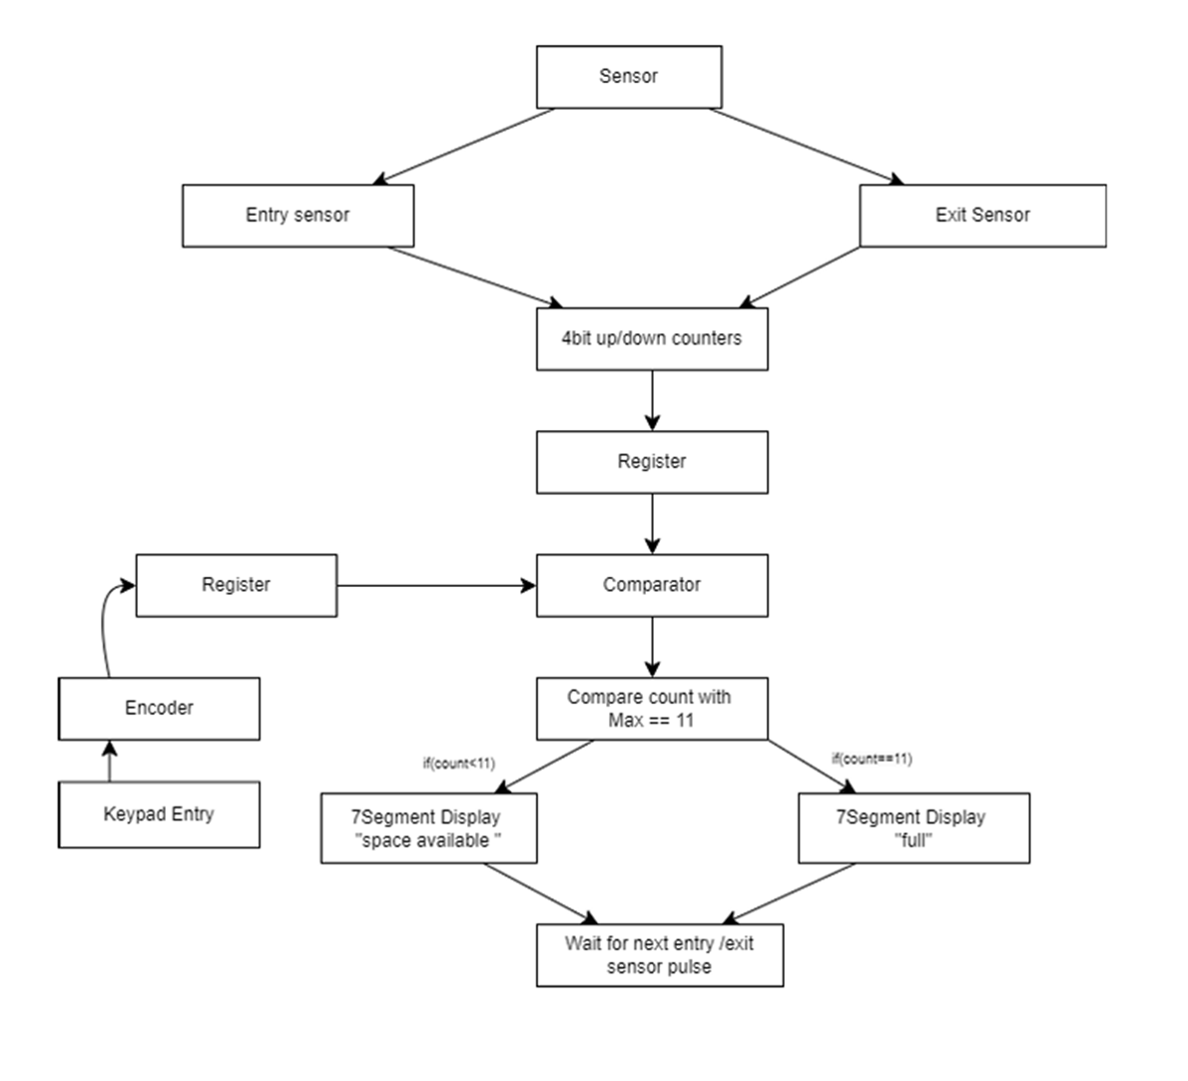
TASK -01
BLOCK DIAGRAM
The block diagram shows a digital parking control system that uses entry and exit sensors connected to a 4-bit up/down counter to track the number of vehicles. The count is stored in a register and compared with a user-defined maximum capacity set via a keypad. Based on the result, the system displays either "SPACE AVAILABLE" (blinking) or "FULL" (steady) on a seven-segment display, using 555 timers. The system updates continuously with each vehicle movement.

Slide 4
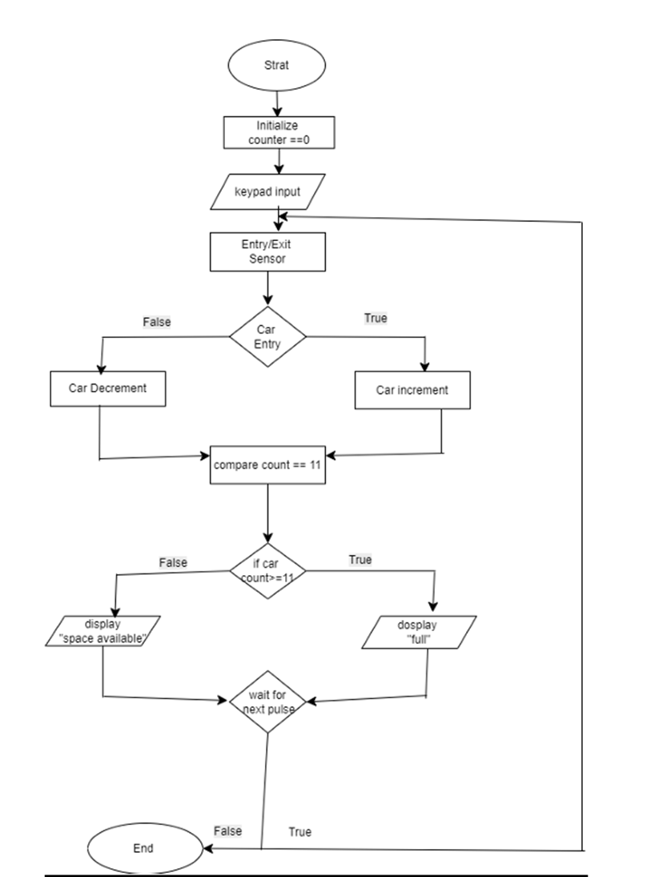
TASK -01
The flowchart shows an automated car parking system that uses sensors to track vehicle entry and exit. It starts by initializing the car count to zero. When a vehicle is detected, the system increments or decrements the count accordingly. If the count reaches 11, it displays “full”; otherwise, it shows “space available.” The system then waits for the next input to update the status.

Slide 5
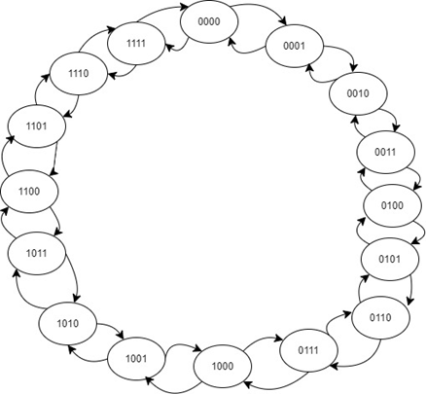
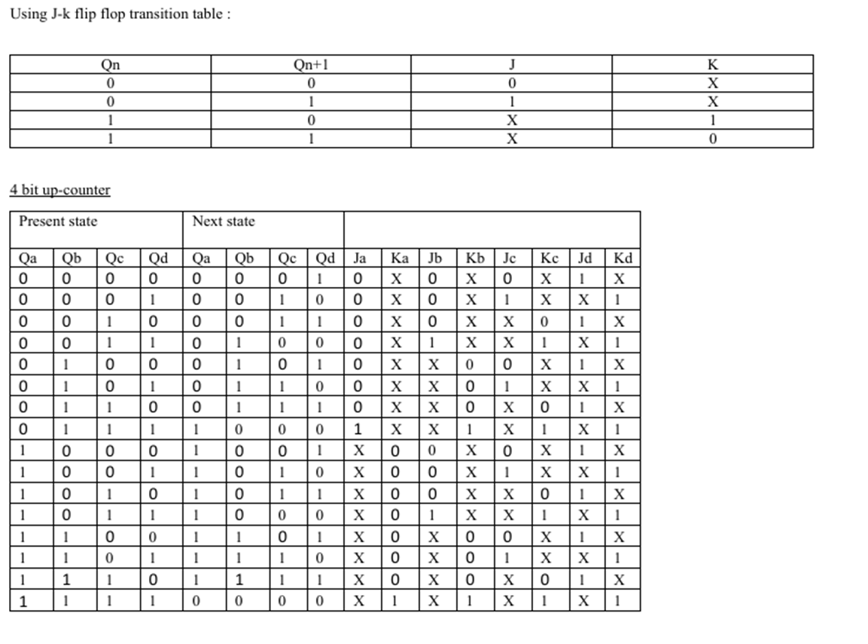
4-bit UP/DOWN Counter
TASK -01

Slide 6
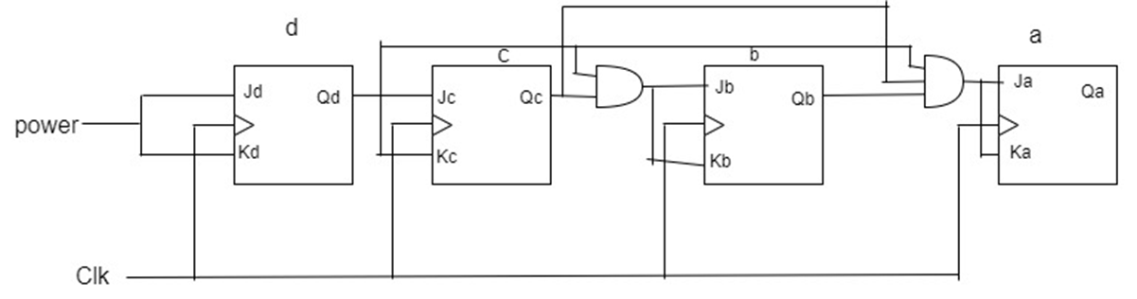
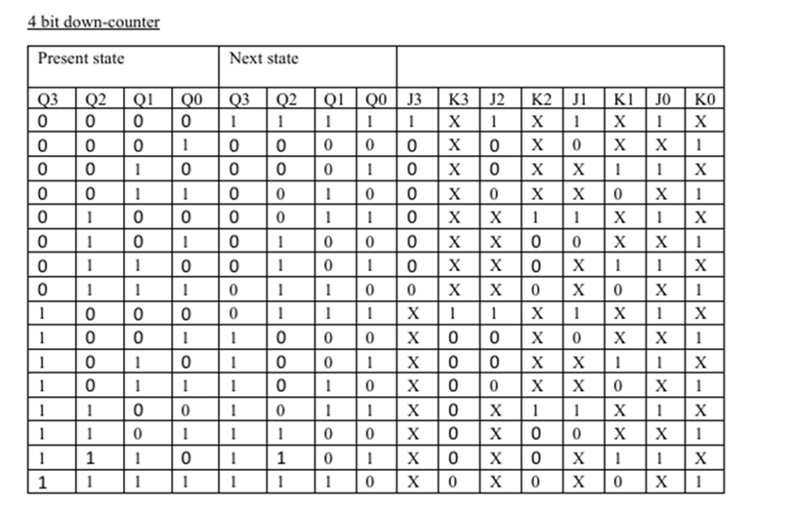
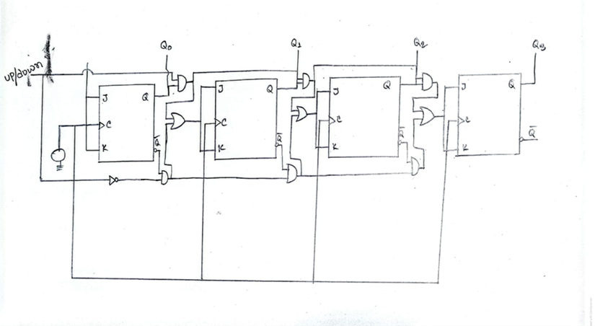
TASK -01

Slide 7
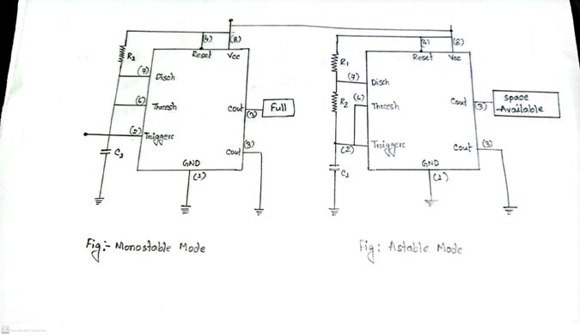
TASK -02
Here, we need to use two 555 timer to show parking status “full” indicator uses a monostable mode to stay continuously ON when triggered for “ SPACE AVAILABLE “ , an astable mode is used to make the display blink

Slide 8
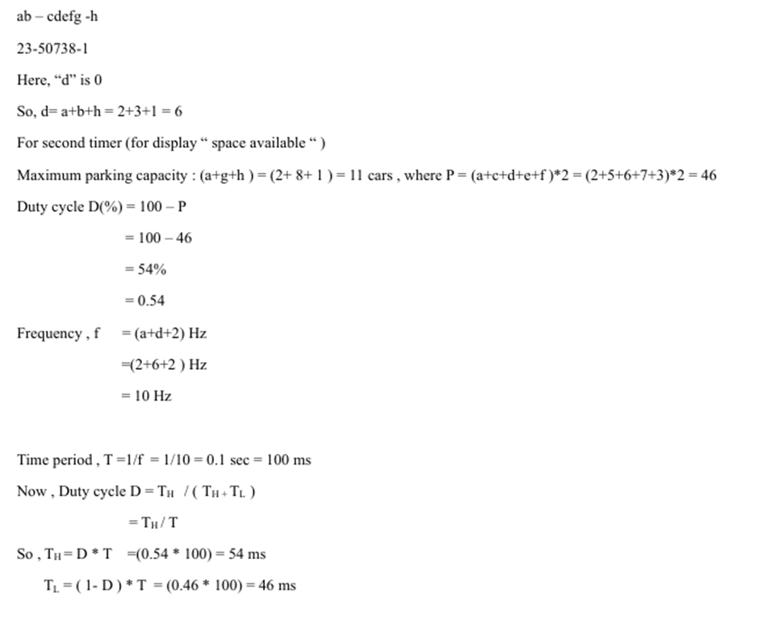
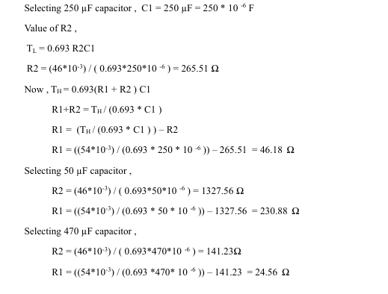
TASK -02

Slide 9
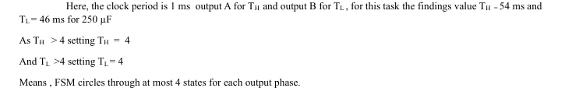
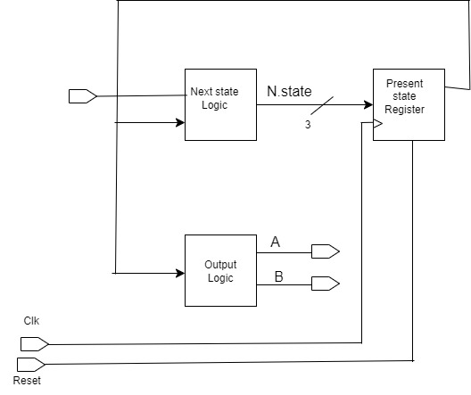
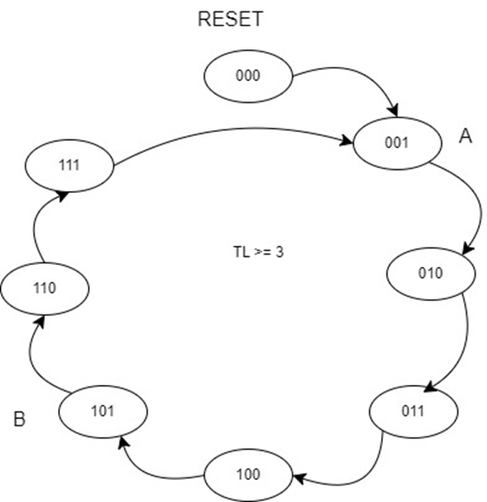
FSM (Finite State Machine)
TASK -03
State chart

Slide 10
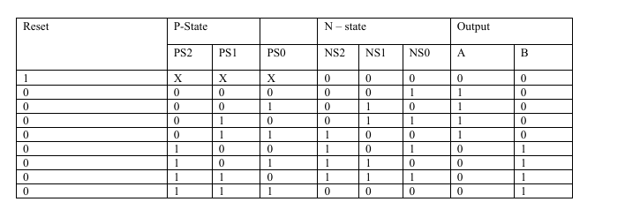
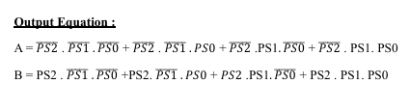
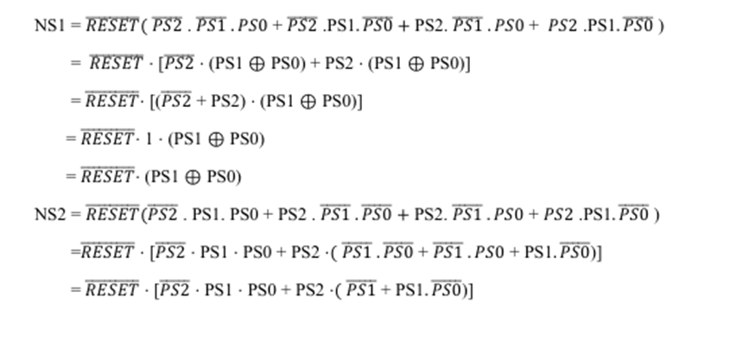
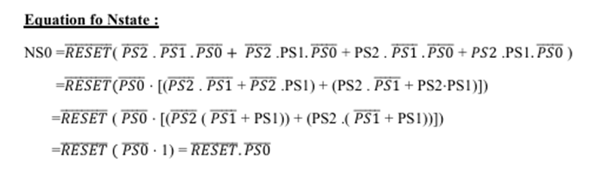
TASK -03

Slide 11
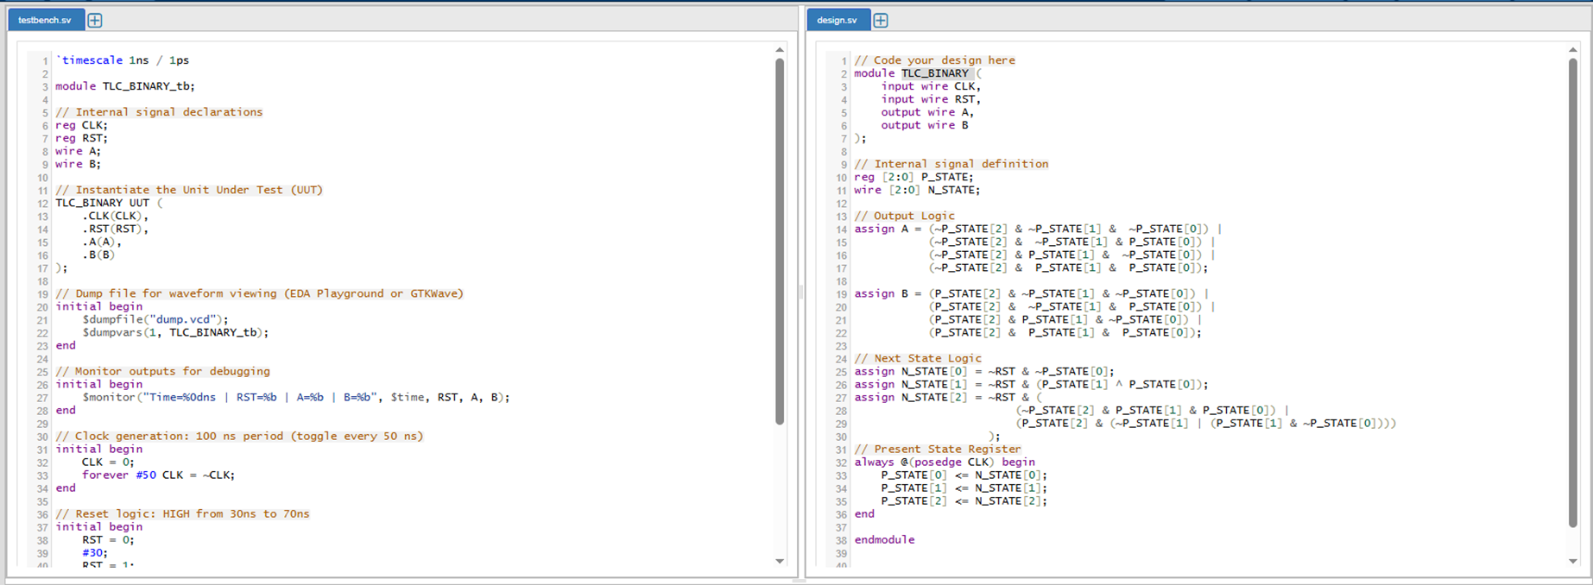
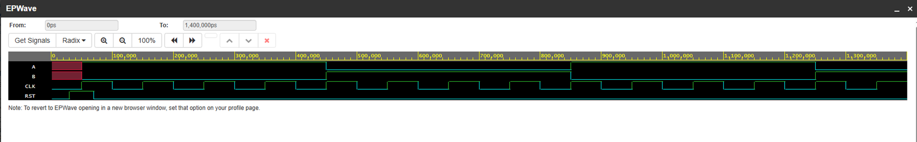
TASK -03

Slide 12
MD.KAMRUL HASAN
TASK -04
Parking Capacity: The system operates with a fixed maximum limit of vehicles, as per the design and ID limit. It can hold (at most) 11 cars maximum. Basically, we assume it from a constant volume (length).
Limited Counter Bit Width If the counter of the design is implemented using flip-flops, it can count up to a certain number of cars. If the number exceeds the range, an overflow may occur, leading to incorrect reading.
The system relies entirely on two 555 timer for generating blinking signals and timing operation, which limits its flexibility.
Entry and exit sensors may generate noisy or bouncing signals, which can result in multiple false triggers and incorrect count of vehicles.
The design cannot be adjusted dynamically because the duty cycle and frequency of blinking are fixed by resistor and capacitor values in the astable mode 555 timer circuit.
Modifications
Impact
Limitations
Implement hardware or software-based debounce mechanisms to filter out false triggers caused by sensor signal noise.
Upgrade to LED or digital display that can show real-time availability of parking slots.
Replace fixed counter with programmable ones to allow counting for longer parking areas.
Add buttons for manual increment and decrement to adjust the count during maintenance or unexpected errors.
Using more components in design may increase the power consumption.
Using digital hardware or software-based filtering mechanisms impacts on durability and scalability for the required system.

Slide 13
UMME MAISHA ISRAT ZISA
TASK -04
Limitations
Modifications
Impact
Limited Functionality of the 555 Timer The 555 timers used in the display system cannot be enabled or disabled externally, as they lack an "enable" control input. This restricts real-time control over the display logic and complicates integration with programmable logic or sensors.
Basic Output Messages The system only toggles between two messages: “FULL” (constantly shown) and “SPACE AVAILABLE” (blinking). There is no real-time information such as exact available spots or guidance for drivers.
No Fault Detection or Handling Sensor errors (e.g., missed counts, double entries) are not accounted for. This can lead to inaccurate car counts, misleading display outputs, and potential overflows.
Poor Scalability with Logic Gates and Flip-Flops Using discrete components (e.g., flip-flops, gates) makes the system large and complex when scaled up. The addition of more parking spaces requires redesigning the entire counter and control logic.
Lack of Real-Time Monitoring Interface Administrators have no way to monitor, reset, or update the system remotely. This makes it less practical for modern applications where centralized control and analytics are essential.
Adopt Microcontrollers or FPGA Platforms Replacing 555 timers and basic flip-flops with microcontrollers (e.g., Arduino, STM32) or FPGAs allows dynamic configuration, precise timing, integrated counting, and flexible control of displays. This supports easy updates and future scalability.
Use Programmable Counters Implement counters in software or reprogrammable hardware, which can track hundreds of cars with minimal wiring. They also support overflow protection, resets, and integration with real-time clocks.
Implement Advanced Displays Use LCD/LED matrix displays to show exact available spots and even zone-wise allocation. Directional guidance can also be provided using arrow indicators.
Sensor Fusion & Redundancy Combine data from multiple sensors (IR, ultrasonic) and apply validation logic to eliminate counting errors. For instance, double-confirm an entry or exit with two sensors to prevent faulty increments.
Add a Communication Interface Use wireless modules (Wi-Fi, GSM, or Bluetooth) to connect with a central server or mobile application. This enables remote monitoring, user notifications, and analytics for usage trends.
Build an Administrator Dashboard Include a simple user interface (on web/mobile) for real-time system status, manual override, capacity update, and system diagnostics. This greatly improves usability and control.
System Complexity Increases: As the number of parking spaces grows, maintaining a system based on discrete ICs and timers becomes impractical. PCB complexity, wiring errors, and power requirements rise exponentially.
Higher Resource Requirements: More memory, processing power, and I/O ports are needed to handle sensor inputs, display control, and communication tasks. Microcontroller-based designs can handle these efficiently.
Improved User Experience: With real-time data and guided parking, users can locate available spaces faster, reducing congestion and improving operational efficiency.
Maintainability and Upgradability: Software-based systems are easier to maintain and update, while hardware-only systems require redesign for every change. FPGA-based solutions offer the best balance between performance and flexibility.

Slide 14
BASUDEB KUNDU
TASK -04
Limitations
Modifications
No power Backup: if the system restart (due to the power failure) the car count is lost
Sensor Bounce and false Triggering
Entry / Exit Sensors may generate multiple tramitions This Can Count
Limited capacity (3 bit): A 3 bit register Can store maximum at 9 cans (from my id)
Not suitable for large parking garages.
555 timer limitations: Astable 555 Can not be directly Frable/disabled via Agic input.
monostable 555 can't hold indirectly needs continuous triggering or Logic override.
No Display Jack mechanism: The segment display may glitch during signal transition without latching
use non-volatile memory to store the can count
use a battery backed resister on microcontroller
use up-to- isolated sensor for higher rehability
Expand the counter to 8 bits (0-255) cars
use a BCD counter with Display decoder for direct output to it segment display
Add a logic AND gate to enable/disable the timer output based on computer logic
use a D-type latch between the timer output and the 7 segment display.
Higher number at cam 235 (8 bit).
Then change:
(1) Encoder (8 bit)
(11) Counter (8 bit)
(iii) Comparator (8 bit)

Slide 15
MD.TAUHIDUL ISLAM
TASK -04
Limitations
Modifications
No power backup: If the system restart (due to the power failure the car counter is lost)
Sensor bounce and false triggering: Entry/exit sensors may generate multiple .this can count
Limited capacity (3 bit): A 3 bit register Can store maximum at 9 cans (from my id)
555 timer limitations: Astable 555 Can not be directly Frable/disabled via Agic input. monostable 555 can't hold indirectly needs continuous triggering or Logic override.
use non-volatile memory to store the can count
use a battery
use up-to- isolated sensor
Expand the counter to 8 bits
Add a logic AND gate
use a D-type latch
Higher number at cam 235 (8 bit).
Then change:
Encoder (8 bit)
Counter (8 bit)
Comparator (8 bit)

Slide 16
Thank you

